Slide 1

Sign Language Detector
Enhancing Communication through Assistive Technology

Slide 2

List of Topics:
Introduction
Unique Solutions
Assistive Technology
Benefits of the Project
How It Works
Future Developments
Defining Aim
Conclusion

Slide 3


Introduction
Welcome to the Sign Language Detector
In our increasingly connected world, effective communication is essential. The Sign Language Detection project leverages advanced technology to bridge communication gaps for those who use sign language.
Objective:
Our goal is to create a solution that facilitates real-time interpretation of sign language gestures through computer vision and machine learning. By using a camera to capture hand movements, our system translates these gestures into understandable text or speech.

Slide 4

Assistive Technology
Assistive Technology includes tools that help individuals with disabilities interact and engage more fully in daily life. The Sign Language Detection project breaks communication barriers using innovative tech solutions.
Empowering Communication
Accessibility Enhancement
Utilizes computer vision and machine learning to bridge the gap between sign language users and non-users. This promotes inclusivity in both personal and professional environments.
Integrates into everyday applications and devices, ensuring communication tools are accessible to users with various needs. Supports their inclusion in environments like schools and workplaces.
Real-Time Translation
Adaptability
Converts hand gestures into readable text or speech instantly, providing seamless and natural communication. This immediate feedback fosters smoother interactions.
Can be customized to support multiple sign languages and dialects, ensuring its effectiveness across different regions. This adaptability makes it relevant to diverse communities.

Slide 5
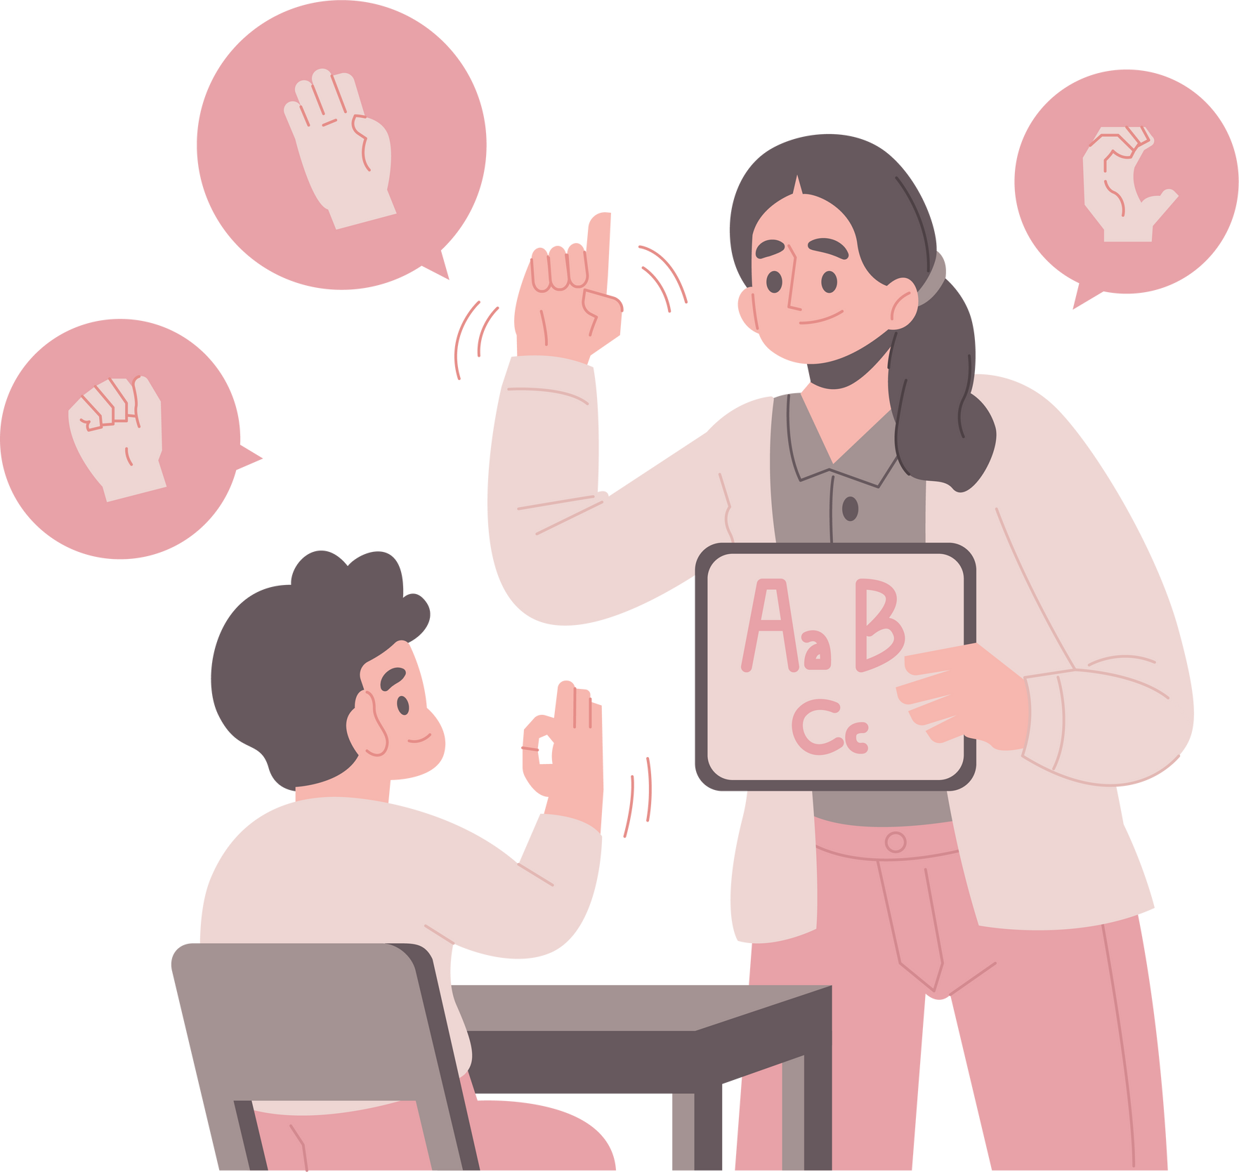
How It Works
Gesture Capture:
A camera records hand movements and gestures made by the user.
Gesture Analysis:
The captured data is processed using machine learning models to identify and interpret the specific signs being made.
Instant Translation:
The recognized signs are converted into readable text or spoken words, allowing for immediate and effective communication.

Slide 6
Unique Solutions
Seamless Communication:
Real-Time Translation: Instantly converts sign language into text, enabling natural conversations.
Broad Applicability:
Customizable for Various Sign Languages: Adapts to multiple sign languages and dialects for regional use.
Enhanced Accessibility:
Cross-Platform Integration: Integrates into web and mobile apps, ensuring accessibility across platforms.
Advanced Gesture Recognition:
High Accuracy: Leverages advanced AI techniques for precise hand sign and gesture recognition.
Continuous Improvement:
Adaptive Learning: Continuously updates with new data to improve accuracy and expand capabilities.
Inclusive Design:
User-Friendly Interface: Offers an intuitive design for easy use by all users, enhancing interaction.

Slide 7




Defining Aim
Build Communication
Express
Ideas
Establish Relationship
Bridge between normal and impaired people
Opportunity to Share Ideas Globally
Foster Positive Relationships Among People

Slide 8


Benefits of the Project
Streamlined Communication:
Simplifies Interaction: Facilitates seamless interactions between individuals who use sign language and those who do not, promoting more effective communication.
Broadened Access:
Enhanced Accessibility: Supports greater inclusion in various settings such as educational institutions, workplaces, and public spaces by making communication more accessible.
Instantaneous Interaction:
Real-Time Engagement: Provides instant translation of sign language gestures, allowing for real-time conversations and reducing communication barriers.
Flexible Integration:
Versatile Application: Can be tailored to different sign languages and integrated into multiple platforms (web, mobile), making it versatile and widely applicable.
Educational Enhancement:
Teaching Aid: Provides a practical tool for learning and teaching sign language, benefiting educators and learners alike.
Increased Autonomy:
Boosts Independence: Allows sign language users to navigate social and professional interactions more confidently and independently.

Slide 9
Future Developments
Model Enhancement: Refine AI models to improve gesture recognition and expand to more complex signs and dialects.
User Feedback Integration: Use real-world feedback to iteratively enhance system performance and user experience.
Multilingual Support: Include support for a wider range of global sign languages to serve diverse communities.
Enhanced Features: Implement contextual understanding and interactive tutorials for more accurate interpretation and user engagement.
Integration with Other Technologies: Combine with voice assistants and AR for a more immersive and seamless user experience.
Mobile and Wearable Devices: Develop applications for mobile and wearable tech to increase accessibility in daily life.
Research and Collaboration: Partner with institutions to advance research and extend the technology's impact and capabilities.
Scalability and Deployment: Utilize cloud services for scalable and reliable technology deployment across the globe.

Slide 10
Conclusion
In conclusion, the Sign Language Detector significantly advances communication by bridging gaps between sign language users and non-users. Through real-time translation, customizable features, and broad applicability, it enhances inclusivity across various environments. Future developments, including model refinement, multilingual support, and integration with emerging technologies, promise to further elevate its impact. By continuously improving and adapting, the project aims to foster greater understanding and accessibility, ultimately empowering individuals and enriching interactions in diverse settings.

Slide 11
Thank You

